Slide 1
Educational Organization Using Service Now
SlideMake.com

Slide 2
Introduction to Educational Organizations Using ServiceNow
ServiceNow is a cloud-based platform that streamlines various administrative and operational processes within educational institutions.
It offers customizable workflows to improve efficiency and student, staff, and faculty experiences.
Implementing ServiceNow helps educational organizations transition to digital-first operations and enhance service delivery.
Notes:
Image source: https://www.servicenow.com

Slide 3
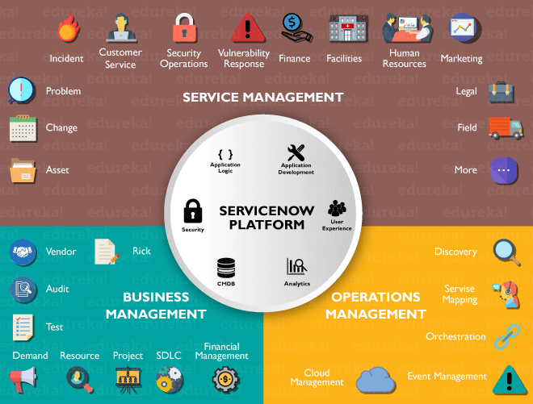
Key Features of ServiceNow for Education
ServiceNow provides a centralized portal for managing IT, HR, facilities, and administrative requests.
Its automation capabilities reduce manual effort and accelerate response times.
The platform supports integrations with existing systems to create a seamless information ecosystem.
Notes:
Image source: https://www.edureka.co

Slide 4
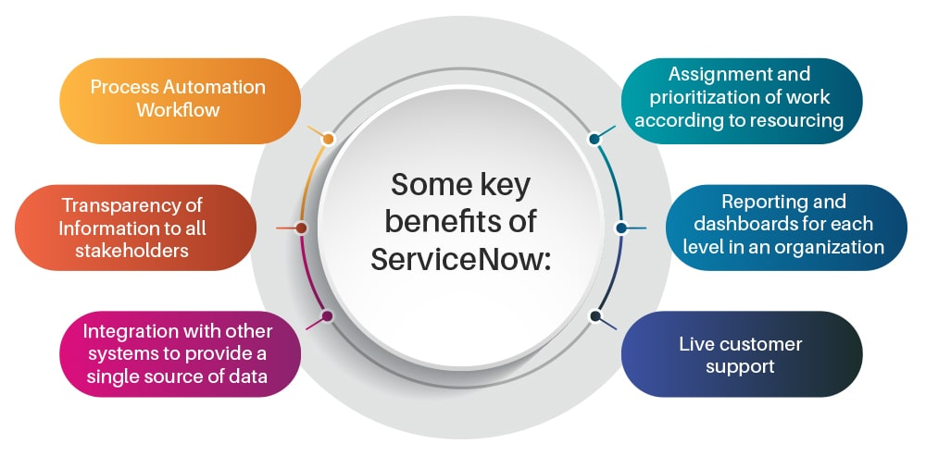
Student Services Management
ServiceNow enables institutions to manage student inquiries, admissions, and registration processes effectively.
Automated workflows help track student progress and provide timely support.
Self-service portals empower students to access information and complete tasks independently.
Notes:
Image source: https://www.jadeglobal.com

Slide 5
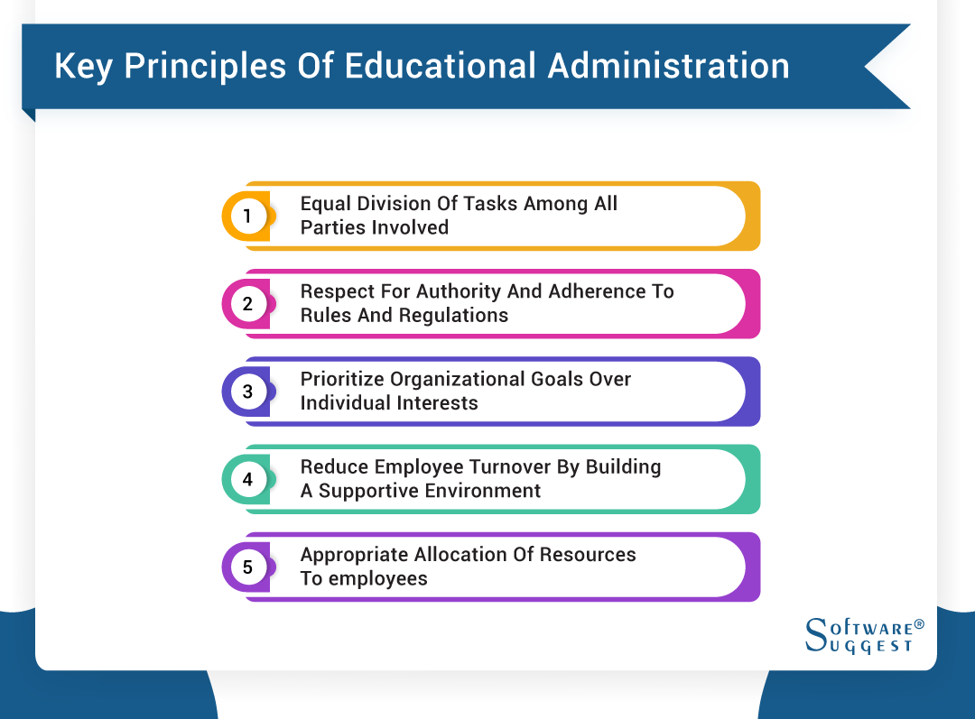
IT Service Management in Education
Educational organizations use ServiceNow to handle IT support tickets, asset management, and change management.
It helps prioritize issues, assign tasks, and track resolutions in real-time.
The platform enhances the overall IT operational efficiency and reduces downtime.
Notes:
Image source: https://softwareauggest-blogimages.s3.ca-central-1.amazonaws.com

Slide 6
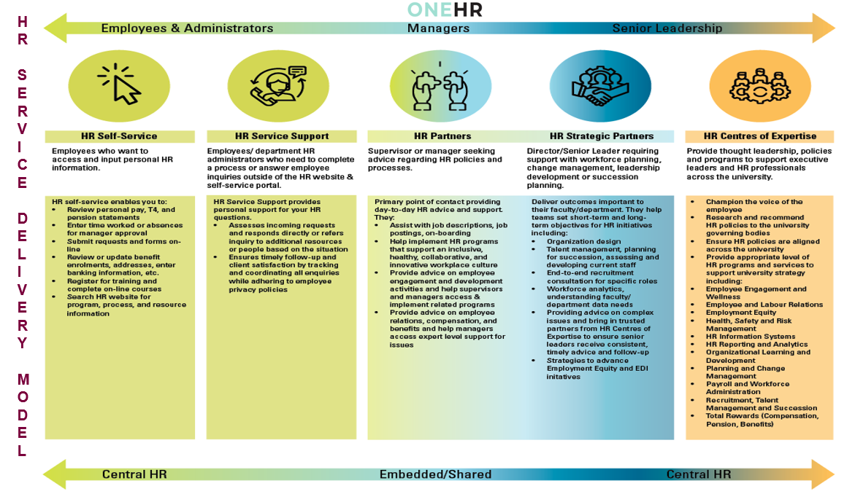
HR Service Delivery for Educational Staff
ServiceNow streamlines HR processes such as onboarding, offboarding, and employee requests.
Automated workflows improve communication and reduce administrative burdens.
The platform supports self-service options for staff to access HR services conveniently.
Notes:
Image source: https://hr-review.mcmaster.ca

Slide 7
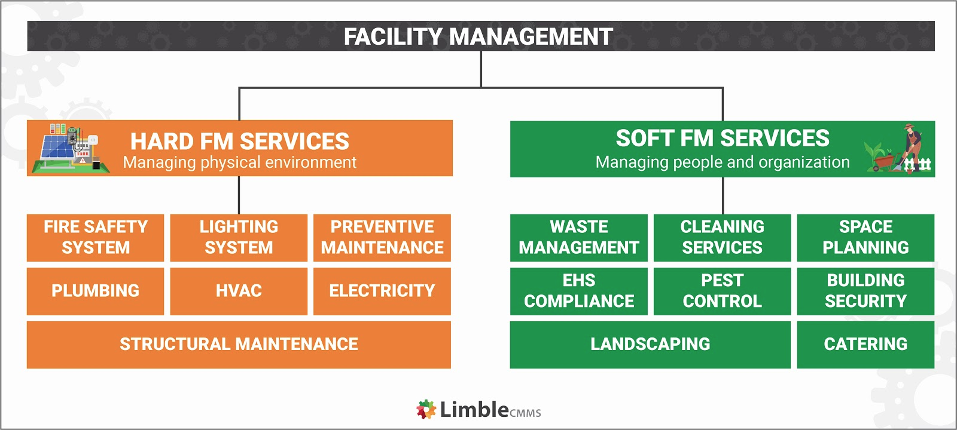
Facilities and Maintenance Management
Educational institutions utilize ServiceNow for maintenance requests, space management, and asset tracking.
It enables proactive scheduling and resource allocation for campus facilities.
Real-time data helps optimize facility operations and improve campus safety.
Notes:
Image source: https://massets.limblecmms.com

Slide 8
Reporting and Analytics for Decision-Making
ServiceNow offers comprehensive dashboards and reports to monitor service performance.
Educational leaders can identify trends, bottlenecks, and areas for improvement.
Data-driven insights support strategic planning and resource allocation.
Notes:
Image source: https://www.servicenow.com

Slide 9
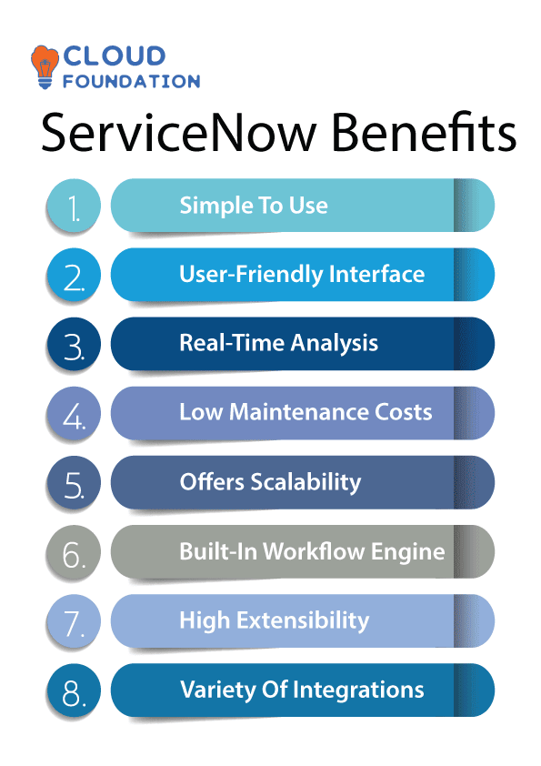
Benefits of Using ServiceNow in Education
Implementation leads to improved operational efficiency and reduced administrative costs.
Enhanced service delivery results in higher satisfaction among students and staff.
The platform supports scalability to accommodate growing organizational needs.
Notes:
Image source: https://cloudfoundation.com

Slide 10
Challenges and Considerations
Customizing ServiceNow requires technical expertise and ongoing maintenance.
Data security and privacy are critical when managing sensitive educational information.
Change management is essential to ensure successful adoption across the institution.
Notes:
Image source: https://www.servicenow.com

Slide 11
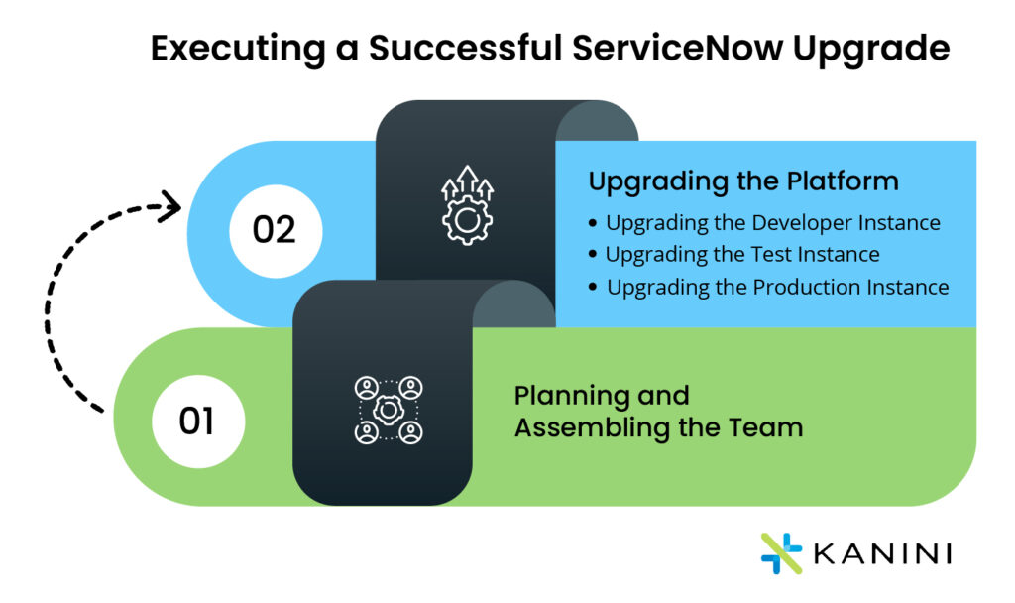
Conclusion and Future Outlook
ServiceNow is a powerful tool for transforming educational organization operations.
Continuous innovation and integration can further enhance campus experiences.
Embracing digital workflows positions educational institutions for future success.
Notes:
Image source: https://kanini.com

Slide 12
References
ServiceNow Official Website. (2023). Education Solutions.
Smith, J. (2022). Digital Transformation in Education. Educational Technology Journal.
Gartner Report. (2023). Cloud Platforms for Educational Institutions.

